Slide 1
Data Access with ADO.NET
Accessing SQL Server and OLE DB from .NET

Slide 2
Table of Contents
Data Access Models – Connected, Disconnected, ORM
ADO.NET Architecture and Data Providers
Accessing SQL Server (Connected Model)
Using SqlConnection , SqlCommand and SqlDataReader
Parameterized Queries
Accessing Other Databases

Slide 3



Data Access Models
Connected Model
ADO.NET
constantly open
connection
DB
DB
ADO.NET client
Database
Disconnected Model
ADO.NET
temporary (offline)
connection
DB
DB
ADO.NET client
Database

Slide 4
Connected Model
Connected data access model
Applicable to an environment where the database is constantly available
Too much effort to issue SQL commands by hand
ADO.NET
constantly open
connection
DB
DB
ADO.NET client
Database

Slide 5
Disconnected Model
Disconnected data access model
A subset of the central database is copied locally at the client and he works with the copy
Database synchronization is done offline
ADO.NET
temporary (offline)
connection
DB
DB
ADO.NET client
Database

Slide 6
ORM Model
ORM data access model
Maps database tables to classes and objects
Objects can be automatically persisted in the database
Can operate in both connected and disconnected modes
OO
Programming
Language
ORM
Framework

Slide 7
ORM Model: Benefits and Problems
ORM model benefits
Increased productivity – writing less code
Use objects with associations instead of tables and SQL commands
Integrated object query mechanism
ORM model drawbacks:
Less flexibility – SQL is automatically generated
Performance issues (sometimes)

Slide 8
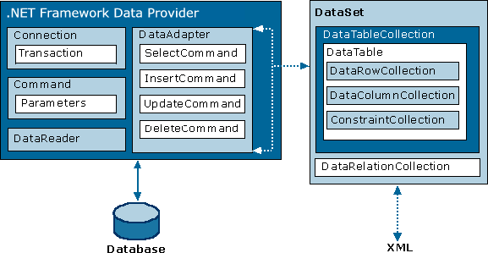
ADO.NET Architecture

Slide 9
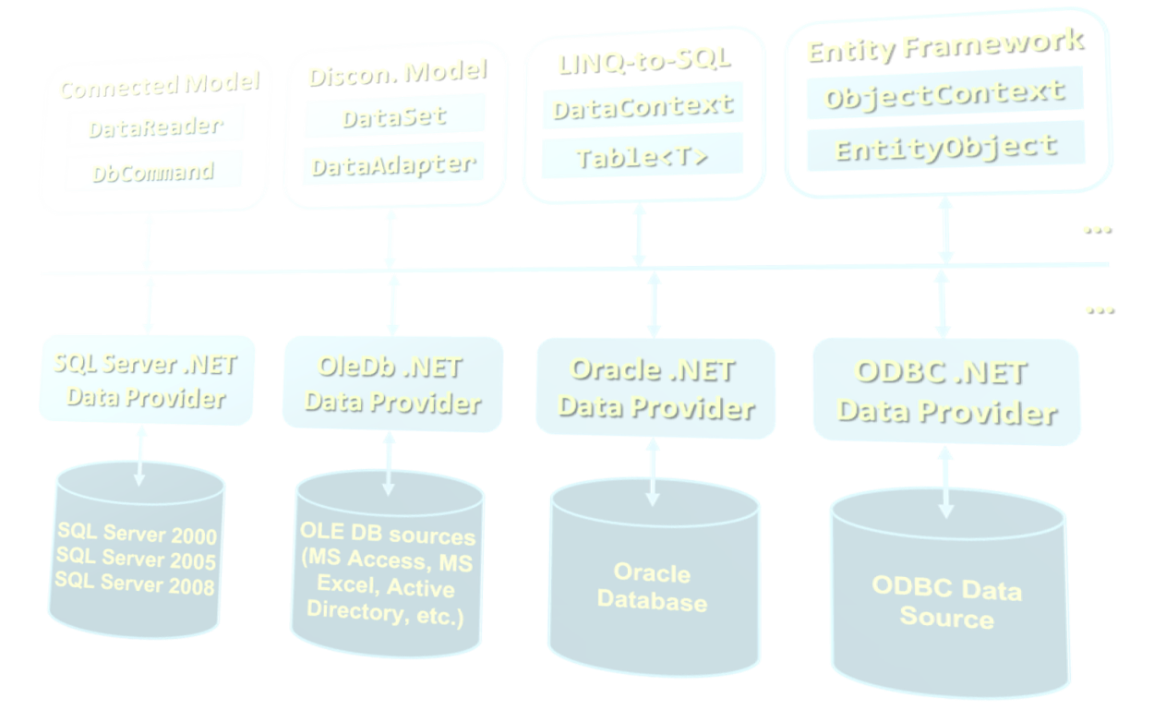
ADO.NET Architecture With Different Model

Slide 10
What is ADO.NET?
ADO.NET is a standard .NET class library for accessing databases, processing data and XML
ActiveX Data Object.
An API for working with data in .NET
Supports connected, disconnected and ORM data access models
Excellent integration with LINQ, XML and WCF
Allows executing SQL in RDBMS systems
DB connections, data readers, DB commands
Supports the ORM approach
LINQ-to-SQL and ADO.NET Entity Framework

Slide 11
Namespaces in ADO.NET
System.Data
ADO.NET core classes
System.Data.Common
Common classes for all ADO.NET technologies
System.Data.Linq
LINQ to SQL framework classes
System.Data.Entity
Entity Framework classes
System.Xml
XML processing classes

Slide 12
Components of ADO.NET
Connected Model
Disconn. Model
LINQ-to-SQL
Entity Framework
DataReader
DataSet
DataContext
ObjectContext
DbCommand
DataAdapter
Table<T>
EntityObject
ADO.NET
Programming Model
SQL Server .NET Data Provider
OleDb .NET Data Provider
Oracle .NET Data Provider
ODBC .NET Data Provider

Slide 13
Data Providers in ADO.NET
Data Providers are collections of classes that provide access to various databases
For different RDBMS systems different Data Providers are available
Each provider uses vendor-specific protocols to talk to the database server
Data providers define several common objects:
Connection – to connect to the database
Command – to execute an SQL command
DataReader – to retrieve data
Entity Framework support (optionally)

Slide 14
Data Providers in ADO.NET (2)
Several standard ADO.NET Data Providers come as part of .NET Framework
SqlClient – accessing SQL Server
OleDB – accessing standard OLE DB data sources
Odbc – accessing standard ODBC data sources
Oracle – accessing Oracle database
Third party Data Providers are available for:
MySQL, PostgreSQL, Interbase, DB2, SQLite
Other RDBMS systems and data sources

Slide 15
Third Party Data Providers
ADO.NET Driver for MySQL (Connector/NET)
http://www.mysql.com/products/connector/
Supports Entity Framework (from version 6.0)
Oracle Data Provider for .NET (ODP.NET)
http://www.oracle.com/technetwork/topics/dotnet
Does not support Entity Framework
.NET Data Provider for PostgreSQL
http://npgsql.projects.postgresql.org/
Supports Entity Framework

Slide 16
Standard Data Provider Classes
System.Data.SqlClient and System.Data.SqlTypes
Data Provider classes for accessing SQL Server
System.Data.OleDb
Classes for accessing OLE DB data sources
System.Data.Odbc
Classes for accessing ODBC data sources
System.Data.Oracle
Classes for accessing Oracle databases

Slide 17
ADO.NET: Connected Model
Retrieving data in connected model
Open a connection (SqlConnection)
Execute command (SqlCommand)
Process the result set of the query by using a reader (SqlDataReader)
Close the reader
Close the connection
SqlDataReader
SqlParameter
SqlParameter
SqlCommand
SqlParameter
SqlConnection
Database

Slide 18
ADO.NET: Disconnected Model
Disconnected model – data is cached in a DataSet
Open a connection (SqlConnection)
Fill a DataSet (using SqlDataAdapter)
Close the connection
Modify the DataSet
Open a connection
Update changes into the DB
Close the connection
DataSet
SqlDataAdapter
SqlConnection
Database

Slide 19
ORM ADO.NET: LINQ to SQL
LINQ to SQL is ORM framework for SQL Server
Create object models mapping the database
Open a data context
Retrieve data with LINQ / modify the tables in the data context
Persist the data context changes into the DB
Connection is auto-closed
Table
Table
Table
DataContext
SqlConnection
Database

Slide 20
ADO.NET: Entity Framework
Entity
Entity Framework is generic ORM framework
Create entity data model mapping the database
Open an object context
Retrieve data with LINQ / modify the tables in the object context
Persist the object context changes into the DB
Connection is auto-closed
Entity
Entity
ObjectContext
EntityClient
Data Provider
SqlConnection
Database

Slide 21

SQL Client Data Provider
SQL

Slide 22
SqlClient Data Provider
SqlConnection
Establish database connection to SQL Server
SqlCommand
Executes SQL commands on the SQL Server through an established connection
Could accept parameters (SQLParameter)
SqlDataReader
Retrieves data (record set) from SQL Server as a result of SQL query execution

Slide 23
ADO.NET Classes for the Connected Model
SqlDataReader
XmlReader
SqlCommand
SqlParameter
SqlParameter
SqlConnection
SqlParameter
Database

Slide 24
The SqlConnection Class
SqlConnection holds a connection to SQL Server database
Requires a valid connection string
Connection string example:
Connecting to SQL Server:
Data Source=(local)\SQLEXPRESS;Initial Catalog=Northwind;Integrated Security=SSPI;
SqlConnection con = new SqlConnection(
"Server=.\SQLEXPRESS;Database=Northwind;
Integrated Security=true");
con.Open();

Slide 25
Connection String
Database connection string
Defines the parameters needed to establish the connection to the database
Main parameters for SQL Server connections:
Provider – name of the DB driver
Data Source / Server – server name / IP address + database instance name
Database / Initial Catalog – database name
User ID / Password – credentials

Slide 26
Connection String (2)
Main parameters for SQL Server connections:
AttachDbFilename=some_db.mdf
Attaches a local database file at startup
Supported by SQL Express only
Server=server_name\database_instance
"." or "(local)" or "SOME_SERVER"
Database instance is "MSSQL", "SQLEXPRESS" or other SQL Server instance name
Integrated Security – true / false

Slide 27
Working with SqlConnection
Explicitly opening and closing a connection
Open() and Close() methods
Works through the connection pool
Implicitly opening and closing the connection
Done automatically by DataAdapters, DataContexts and ObjectContexts
Connections are IDisposable objects
Can be managed with the using construct

Slide 28
SqlConnection – Example
Creating and opening connection to SQL Server (database DUIITAcademy)
SqlConnection dbCon = new SqlConnection(
"Server=.\\SQLEXPRESS; " +
"Database=DUIITAcademy; " +
"Integrated Security=true");
dbCon.Open();
using(dbCon)
{
// Use the connection to execute SQL commands here …
}

Slide 29
SqlClient and ADO.NET Connected Model
Retrieving data in connected model
Open a connection (SqlConnection)
Execute command (SqlCommand)
Process the result set of the query by using a reader (SqlDataReader)
Close the reader
Close the connection
SqlDataReader
SqlParameter
SqlParameter
SqlCommand
SqlParameter
SqlConnection
Database

Slide 30
The SqlCommand Class
Executes an SQL statement or a stored procedure
More important properties
Connection – gets / sets the SqlConnection of the command
CommandType – the type of the command
CommandType.StoredProcedure
CommandType.TableDirect
CommandType.Text
CommandText – the body of the SQL query or the name of the stored procedure
Parameters

Slide 31
The SqlCommand Class (2)
More important methods
ExecuteScalar()
Returns a single value (the value in the first column of the first row of the result set)
The returned value is System.Object but can be casted to the actual returned data type
ExecuteReader()
Returns a SqlDataReader
It is a cursor over the returned records (result set)
CommandBehavior – assigns some options

Slide 32
The SqlCommand Class (3)
More important methods
ExecuteNonQuery()
Used for non-query SQL commands, e.g. INSERT
Returns the number of affected rows (int)
ExecuteXmlReader()
Returns the record set as XML
Returns an XmlReader
Supported in SqlClient Data Provider only

Slide 33
SqlCommand – Example
SqlConnection dbCon = new SqlConnection(
"Server=.\\SQLEXPRESS; " +
"Database=TelerikAcademy; " +
"Integrated Security=true");
dbCon.Open();
using(dbCon)
{
SqlCommand command = new SqlCommand(
"SELECT COUNT(*) FROM Employees", dbCon);
decimal employeesCount = command.ExecuteScalar();
Console.WriteLine("Employees count: {0} ",
employeesCount);
}

Slide 34
The SqlDataReader Class
SqlDataReader retrieves a sequence of records (cursor) returned as result of an SQL command
Data is available for reading only (can't be changed)
Forward-only row processing (no move back)
Important properties and methods:
Read() – moves the cursor forward and returns false if there is no next record
Item (indexer) – retrieves the value in the current record by given column name or index
Close() – closes the cursor and releases resources

Slide 35
SqlDataReader – Example
SqlConnection dbCon = new SqlConnection(…);
dbCon.Open();
using(dbCon)
{
SqlCommand command = new SqlCommand(
"SELECT * FROM Employees", dbCon);
SqlDataReader reader = command.ExecuteReader();
using (reader)
{
while (reader.Read())
{
string firstName = (string)reader["FirstName"];
string lastName = (string)reader["LastName"];
decimal salary = (decimal)reader["Salary"];
Console.WriteLine("{0} {1} - {2}",
firstName, lastName, salary);
}
}
}

Slide 36
The SqlParameter Class
What are SqlParameters?
SQL queries and stored procedures can have input and output parameters
Accessed through the Parameters property of the SqlCommand class
Important properties of SqlParameter:
ParameterName – name of the parameter
DbType – SQL type (NVarChar, Timestamp, …)
Size – size of the type (if applicable)
Direction – input / output

Slide 37
Parameterized Commands – Example
private void InsertProject(string name, string description,
DateTime startDate, DateTime? endDate)
{
SqlCommand cmd = new SqlCommand("INSERT INTO Projects " +
"(Name, Description, StartDate, EndDate) VALUES " +
"(@name, @desc, @start, @end)", dbCon);
cmd.Parameters.Add(new SqlParameter("@name", name));
cmd.Parameters.Add(new SqlParameter("@desc", description));
cmd.Parameters.Add(new SqlParameter("@start", startDate));
SqlParameter sqlParameterEndDate =
new SqlParameter("@end", endDate);
if (endDate == null)
sqlParameterEndDate.Value = DBNull.Value;
cmd.Parameters.Add(sqlParameterEndDate);
cmd.ExecuteNonQuery();
}

Slide 38
Primary Key Retrieval
Retrieval of an automatically generated primary key is specific to each database server
In SQL Server IDENTITY column is used
Obtained by executing the following query:
Example of obtaining the automatically generated primary key in ADO.NET:
SELECT @@Identity
SqlCommand selectIdentityCommand =
new SqlCommand("SELECT @@Identity", dbCon);
int insertedRecordId = (int)
(decimal) selectIdentityCommand.ExecuteScalar();

Slide 39
SqlCommand: Using Stored Procedures
SqlCommand requires following configuration to execute a stored procedure.
Set the stored procedure name
Set the command type as CommantType.StoredProcedure
Set the SqlParameter to send parameter to the SP.

Slide 40
SqlCommand: Using Stored Procedures Example
SqlCommand cmd = new SqlCommand( "CustOrderHist", conn);
cmd.CommandType = CommandType.StoredProcedure;
cmd.Parameters.Add( new SqlParameter("@CustomerID", custId));
cmd.ExecuteReader();

Slide 41
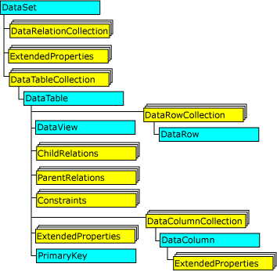
ADO.Net DataSet and Adapters
A DataSet is an in-memory data store that can hold numerous tables.
DataSets only hold data and do not interact with a data source.
It is the SqlDataAdapter that manages connections with the data source and gives us disconnected behavior.
DataSet

Slide 42
ADO.Net DataSet and Adapters(2)
The SqlDataAdapter opens a connection only when required and closes it as soon as it has performed its task.
The SqlDataAdapter performs the following tasks when filling a DataSet with data:
Open connection
Retrieve data into DataSet
Close connection

Slide 43
ADO.Net DataSet and Adapters(3)
Creating a DataSet Object
DataSet dsCustomers = new DataSet();
Creating A SqlDataAdapter
SqlDataAdapter daCustomers = new SqlDataAdapter( "select CustomerID, CompanyName from Customers", conn);
Filling the DataSet
daCustomers.Fill(dsCustomers, "Customers");
Using the DataSet
dgCustomers.DataSource = dsCustomers; dgCustomers.DataMember = "Customers"
Updating Changes
daCustomers.Update(dsCustomers, "Customers");

Slide 44
ADO.Net DataSet additional functionalities
Adding Multiple Tables
Adding a Relationship Between Tables
Merging DataSet Contents
Copying DataSet Contents

Slide 45
ADO.Net DataView
A DataView enables us to create different views of the data stored in a DataTable, a capability that is often used in data-binding applications.
A DataView provides a dynamic view of data in the underlying DataTable: the content, ordering, and membership reflect changes as they occur.
We can also use a DataViewManager to manage view settings for all the tables in a DataSet.

Slide 46
Creating a DataView
There are two ways to create a DataView.
We can use the DataView constructor
DataView custDV = new DataView(custDS.Tables["Customers"], "Country = 'USA'", "ContactName", DataViewRowState.CurrentRows);
We can also create a reference to the DefaultView property of the DataTable.
DataView custDV = custDS.Tables["Customers"].DefaultView;

Slide 47
Sorting and Filtering Data Using a DataView
We can use the Sort property to specify single or multiple column sort orders and include ASC (ascending) and DESC (descending) parameters.
We can use the ApplyDefaultSort property to automatically create a sort order, in ascending order, based on the primary key column or columns of the table.
We can use the RowFilter property to specify subsets of rows based on their column values.
We can use the RowStateFilter property to specify which row versions to view.
DataView prodView = new DataView(prodDS.Tables["Products"], "UnitsInStock <= ReorderLevel", "SupplierID, ProductName", DataViewRowState.CurrentRows);

Slide 48


Connecting to Non-Microsoft Databases

Slide 49
Connecting to Non-Microsoft Databases
ADO.NET supports accessing various databases via their Data Providers:
OLE DB – supported internally in ADO.NET
Access any OLE DB-compliant data source
E.g. MS Access, MS Excel, MS Project, MS Exchange, Windows Active Directory, text files
Oracle – supported internally in ADO.NET
MySQL – third party data provider
PostgreSQL – third party data provider

Slide 50
ADO.NET Data Interfaces
ADO.NET Data Providers implement the following interfaces:
IDbConnection
IDbCommand, IDataParameter
IDataReader
IDbDataAdapter

Slide 51
ADO.NET Base Classes
ADO.NET provides the following base classes:
DbConnection
DbCommand / DbParameter
DbDataReader
DbTransaction
DbParameterCollection
DbDataAdapter
DbCommandBuilder
DbConnectionStringBuilder
DbDataPermission

Slide 52
OLE DB Data Provider
OleDbConnection – establishes a connection to an OLE DB source of data
OleDbCommand – executes an SQL commands through an OLE DB connection to a DB
OleDbParameter – parameter for a command
OleDbDataReader – to retrieve data from a command, executed through OLE DB
OleDbConnection dbConn = new OleDbConnection(
@"Provider=Microsoft.Jet.OLEDB.4.0;Data
Source=C:\MyDB.mdb;Persist Security Info=False");

Slide 53

Connecting To OLE DB – Example
Suppose we have MS Access database C:\Library.mdb
We have the table Users:
We use the "Microsoft Jet 4.0 Provider" to connect in ADO.NET through OLE DB
We create a connection string component:
Provider=Microsoft.Jet.OLEDB.4.0;Data Source= C:\Library.mdb;Persist Security Info=False

Slide 54
References
http://www.csharp-station.com/Tutorial/AdoDotNet
http://msdn.microsoft.com/en-us/library/e80y5yhx(v=vs.80)
http://www.codeproject.com
Download the application and presentation
https://docs.google.com/open?id=0B5b3ZcIvnbMrdHlOSDRXWG9mbDA

Slide 55
Data Access with ADO.NET
Questions?

